Slide 1
An Introduction to the Internet and the Web
Frank McCown
COMP 250 – Internet Development
Harding University

Slide 2
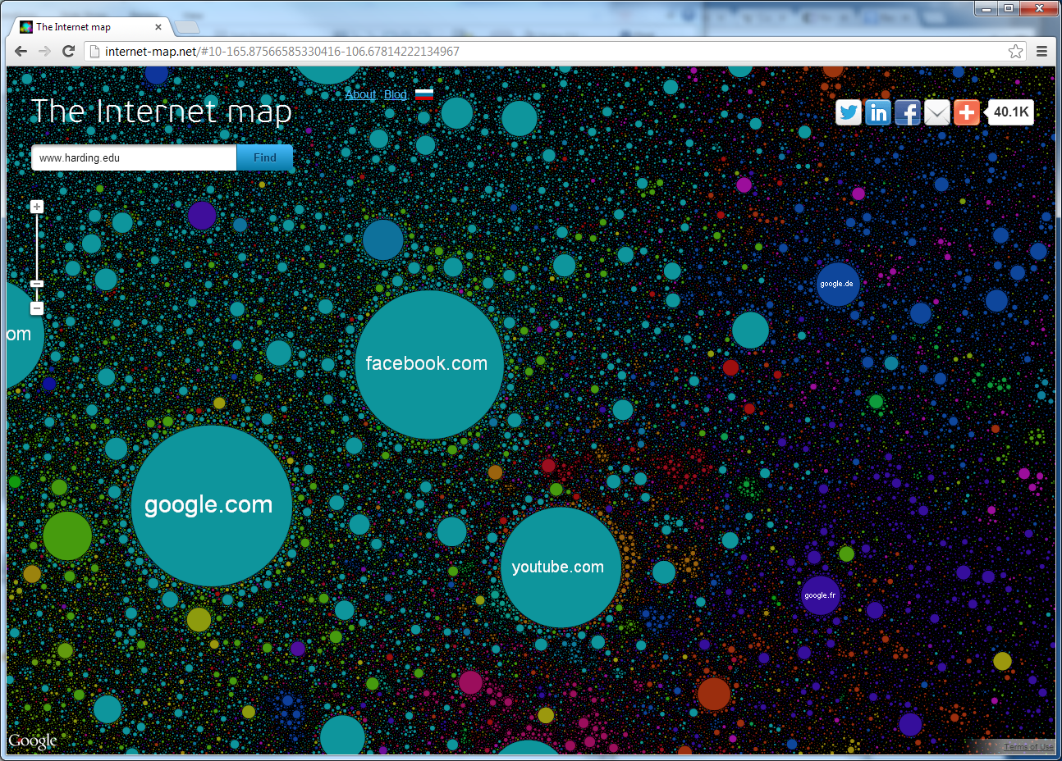
http://internet-map.net/
Notes:
Created from Alexa web browser toolbar. “Every site is a circle on the map, and its size is determined by website traffic, the larger the amount of traffic, the bigger the circle. Users’ switching between websites forms links, and the stronger the link, the closer the websites tend to arrange themselves to each other.”

Slide 3
“The Internet is a global system of interconnected computer networks that use the standard Internet Protocol Suite (TCP/IP) to serve billions of users worldwide.” http://en.wikipedia.org/wiki/Internet
Internet
Computer 1
Computer 2
255.254.253.252
1.2.3.4

Slide 4
Internet Protocol Suite
Internet Protocol (IP): directs packets to a specific computer using an IP address
Transmission Control Protocol (TCP): directs packets to a specific application on a computer using a port number.
Common port numbers:
22 – ssh
23 – telnet
25 – email
80 – Web

Slide 5
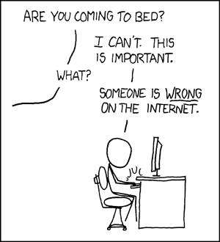

Slide 6
Internet ≠ Web
File transfer
Web
IM
VoIP
Streaming video
email
The Internet
Notes:
BitTorrent – accounts for about half of all Internet traffic
VoIP(Voice over Internet Protocol)

Slide 7
Overview of the Web
Internet
Client – Web Browser
Web Server
255.254.253.252
1.2.3.4
World Wide Web: The system of interlinked hypertext documents accessed over the Internet using the HTTP protocol

Slide 8
Web Browser
Software that runs on the client used to access and display web content
http://gs.statcounter.com/

Slide 9
Mobile Web Browser
http://gs.statcounter.com/#mobile+tablet-browser-ww-monthly-201505-201605

Slide 10
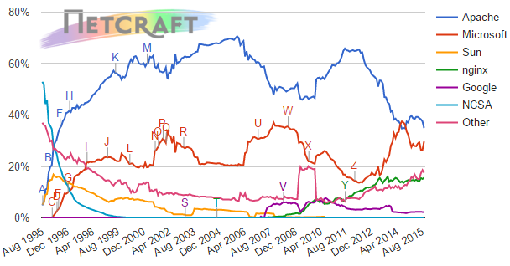
Web Server
A computer (or software running on a computer) on the Internet that listens for HTTP requests, typically on port 80, and responds with HTTP responses
Market Share for Top Servers Across All Domains, Aug 1995 – Sep 2015
Apache : 35%
Microsoft IIS: 30%
ngnix: 16%
Google: 2%
http://news.netcraft.com/archives/category/web-server-survey/

Slide 11
Hypertext Transfer Protocol (HTTP)
Protocol that runs over TCP/IP and governs communication between web browsers and web servers
Client Request
GET /comp HTTP/1.1
Host: www.harding.edu
Server Response
HTTP/1.1 200 OK
Content-Length: 6018 Content-Type: text/html Content-Location: http://www.harding.edu/comp Last-Modified: Mon, 05 Jul 2014 18:49:40 GMT
Server: nginx
<!DOCTYPE html>
<html>
<meta content="IE=edge" http-equiv="X-UA-Compatible">
<head>
Example request for http://www.harding.edu/comp

Slide 12
Uniform Resource Locator (URL)
A URL identifies the location of a resource on the Web.
local hostname
domain name
TLD
http://www.foo.org/abc/bar.html
scheme
hostname
path

Slide 13
Domain Name System (DNS)
DNS is a hierarchical look-up service that converts a given hostname into its equivalent IP address
DNS Server
www.harding.edu
128.82.4.20
www.google.com → 1.4.5.8
www.cnn.com → 4.6.2.8
www.hulu.com → 6.7.8.9
Etc ...
DNS servers contact parent servers for missing entries
Authoritative name servers are responsible for specific domains
Warning: DNS cache poisoning

Slide 14
Example: Web Page Request
DNS
(1) Enter URL
(2) foo.org
(3) 1.2.3.4
http://foo.org/bar.html
(4) HTTP GET bar.html
(5) Locate the resource
(6) HTTP Response
(7) Parse HTML & display
(8) HTTP GET image1
(N) HTTP GET imageX
Potentially many requests & responses
Client (Web Browser)
Web Server

Slide 15
Dissecting the Request
Request type
GET /comp HTTP/1.1
Host: www.harding.edu
User-Agent: Mozilla/5.0 Firefox/3.6.8

Slide 16
Dissecting the Request
Path
GET /comp HTTP/1.1
Host: www.harding.edu
User-Agent: Mozilla/5.0 Firefox/3.6.8

Slide 17
Dissecting the Request
HTTP version
GET /comp HTTP/1.1
Host: www.harding.edu
User-Agent: Mozilla/5.0 Firefox/3.6.8

Slide 18
Dissecting the Request
Hostname
GET /comp HTTP/1.1
Host: www.harding.edu
User-Agent: Mozilla/5.0 Firefox/3.6.8

Slide 19
Dissecting the Request
Identify client
GET /comp HTTP/1.1
Host: www.harding.edu
User-Agent: Mozilla/5.0 Firefox/3.6.8

Slide 20
Dissecting the Response
HTTP version
Status code & phrase
HTTP/1.1 200 OK
Content-Length: 6018 Content-Type: text/html Content-Location: http://www.harding.edu/comp/ Last-Modified: Mon, 05 Jul 2010 18:49:40 GMT
Server: Microsoft-IIS/6.0
<!DOCTYPE html PUBLIC "-//W3C//DTD HTML 4.01//EN" "http://www.w3.org/TR/html4/strict.dtd"> <html> <head> <title>Harding University - Computer Science</title>
Etc...
Header
Message body

Slide 21
Status Line
Status code & phrase
HTTP/1.1 200 OK
HTTP version
Popular status codes:
200 Successful
301 Moved permanently
302 Found under different temporary URI
304 Not modified
403 Forbidden
404 Not found
500 Internal server error

Slide 22
Dissecting the Response
Number of bytes in response
HTTP/1.1 200 OK
Content-Length: 6018 Content-Type: text/html Content-Location: http://www.harding.edu/comp/ Last-Modified: Mon, 05 Jul 2010 18:49:40 GMT
Server: Microsoft-IIS/6.0
<!DOCTYPE html PUBLIC "-//W3C//DTD HTML 4.01//EN" "http://www.w3.org/TR/html4/strict.dtd"> <html> <head> <title>Harding University - Computer Science</title>
Etc...
Header
Message body

Slide 23
Dissecting the Response
MIME type
HTTP/1.1 200 OK
Content-Length: 6018 Content-Type: text/html Content-Location: http://www.harding.edu/comp/ Last-Modified: Mon, 05 Jul 2010 18:49:40 GMT
Server: Microsoft-IIS/6.0
<!DOCTYPE html PUBLIC "-//W3C//DTD HTML 4.01//EN" "http://www.w3.org/TR/html4/strict.dtd"> <html> <head> <title>Harding University - Computer Science</title>
Etc...
Header
Message body

Slide 24
Popular MIME types
application/pdf
application/msword
application/vnd.ms-excel
video/quicktime
text/html
text/plain
image/jpeg
image/gif
image/png
IANA list of MIME types

Slide 25
Dissecting the Response
URI for resource
HTTP/1.1 200 OK
Content-Length: 6018 Content-Type: text/html Content-Location: http://www.harding.edu/comp/ Last-Modified: Mon, 05 Jul 2010 18:49:40 GMT
Server: Microsoft-IIS/6.0
<!DOCTYPE html PUBLIC "-//W3C//DTD HTML 4.01//EN" "http://www.w3.org/TR/html4/strict.dtd"> <html> <head> <title>Harding University - Computer Science</title>
Etc...
Header
Message body

Slide 26
Dissecting the Response
When the file was last modified on the server
HTTP/1.1 200 OK
Content-Length: 6018 Content-Type: text/html Content-Location: http://www.harding.edu/comp/ Last-Modified: Mon, 05 Jul 2010 18:49:40 GMT
Server: Microsoft-IIS/6.0
<!DOCTYPE html PUBLIC "-//W3C//DTD HTML 4.01//EN" "http://www.w3.org/TR/html4/strict.dtd"> <html> <head> <title>Harding University - Computer Science</title>
Etc...
Header
Message body

Slide 27
Dissecting the Response
HTTP/1.1 200 OK
Content-Length: 6018 Content-Type: text/html Content-Location: http://www.harding.edu/comp/ Last-Modified: Mon, 05 Jul 2010 18:49:40 GMT
Server: Microsoft-IIS/6.0
<!DOCTYPE html PUBLIC "-//W3C//DTD HTML 4.01//EN" "http://www.w3.org/TR/html4/strict.dtd"> <html> <head> <title>Harding University - Computer Science</title>
Etc...
Web server software
Header
Message body

Slide 28
Dissecting the Response
HTTP/1.1 200 OK
Content-Length: 6018 Content-Type: text/html Content-Location: http://www.harding.edu/comp/ Last-Modified: Mon, 05 Jul 2010 18:49:40 GMT
Server: Microsoft-IIS/6.0
<!DOCTYPE html PUBLIC "-//W3C//DTD HTML 4.01//EN" "http://www.w3.org/TR/html4/strict.dtd"> <html> <head> <title>Harding University - Computer Science</title>
Etc...
Header
Message body
HTML displayed in the browser

Slide 29
How can I see the HTTP headers?
Chrome
Ctrl-Shift-I → Developer Tools
“Network” button
Firefox
Ctrl-Shift-K →Web Console
“Net” button should be down
Internet Explorer
F12 →Developer Tools
“Network” tab

Slide 30
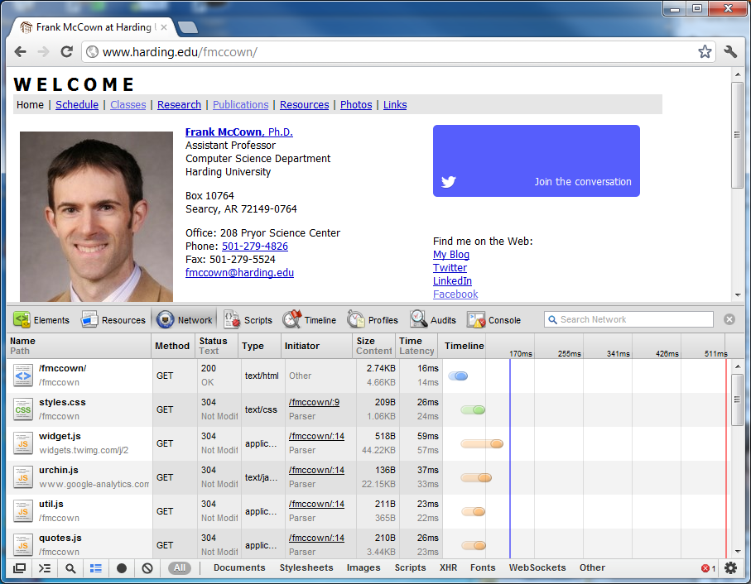

Slide 31
